Slide 1
DecarbCities conference
Session "Solutions to decarbonise multi-family buildings: let’s do it!"
CENTRALIZING OF INDIVIDUAL
GAS Floor heaters
Daniela Huber – dwelling stock management / SOZIALBAU AG

Slide 2
Fact-Sheet: SOZIALBAU AG
SOZIALBAU AG is the biggest non-for-profit housing association in Austria.
120,000 inhabitants (about 7% of vienna) in
53,000 dwellings
6.000 of which are still heated with individual gas floor heaters (about 400,000 in vienna!)
Notes:
.

Slide 3
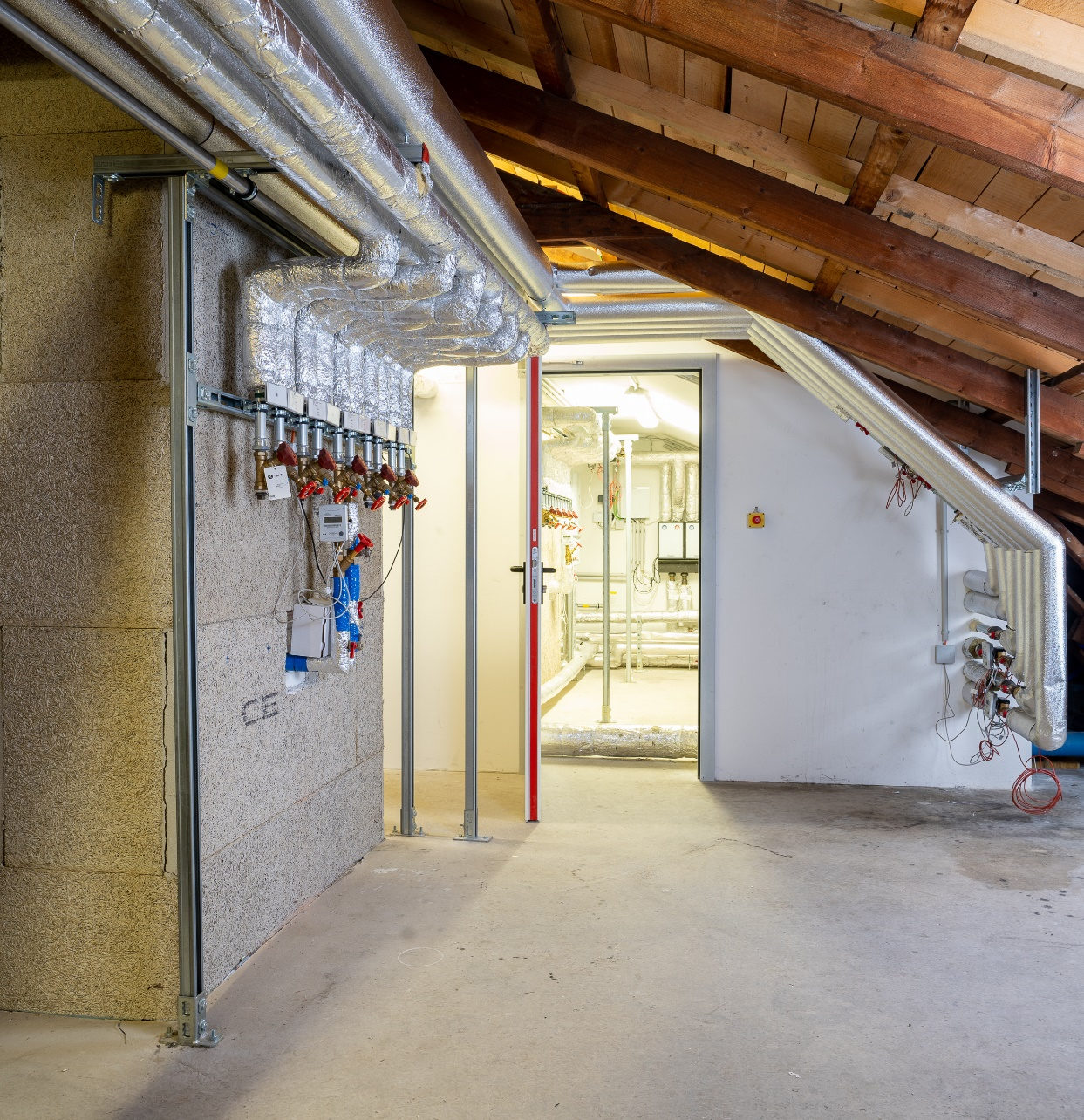
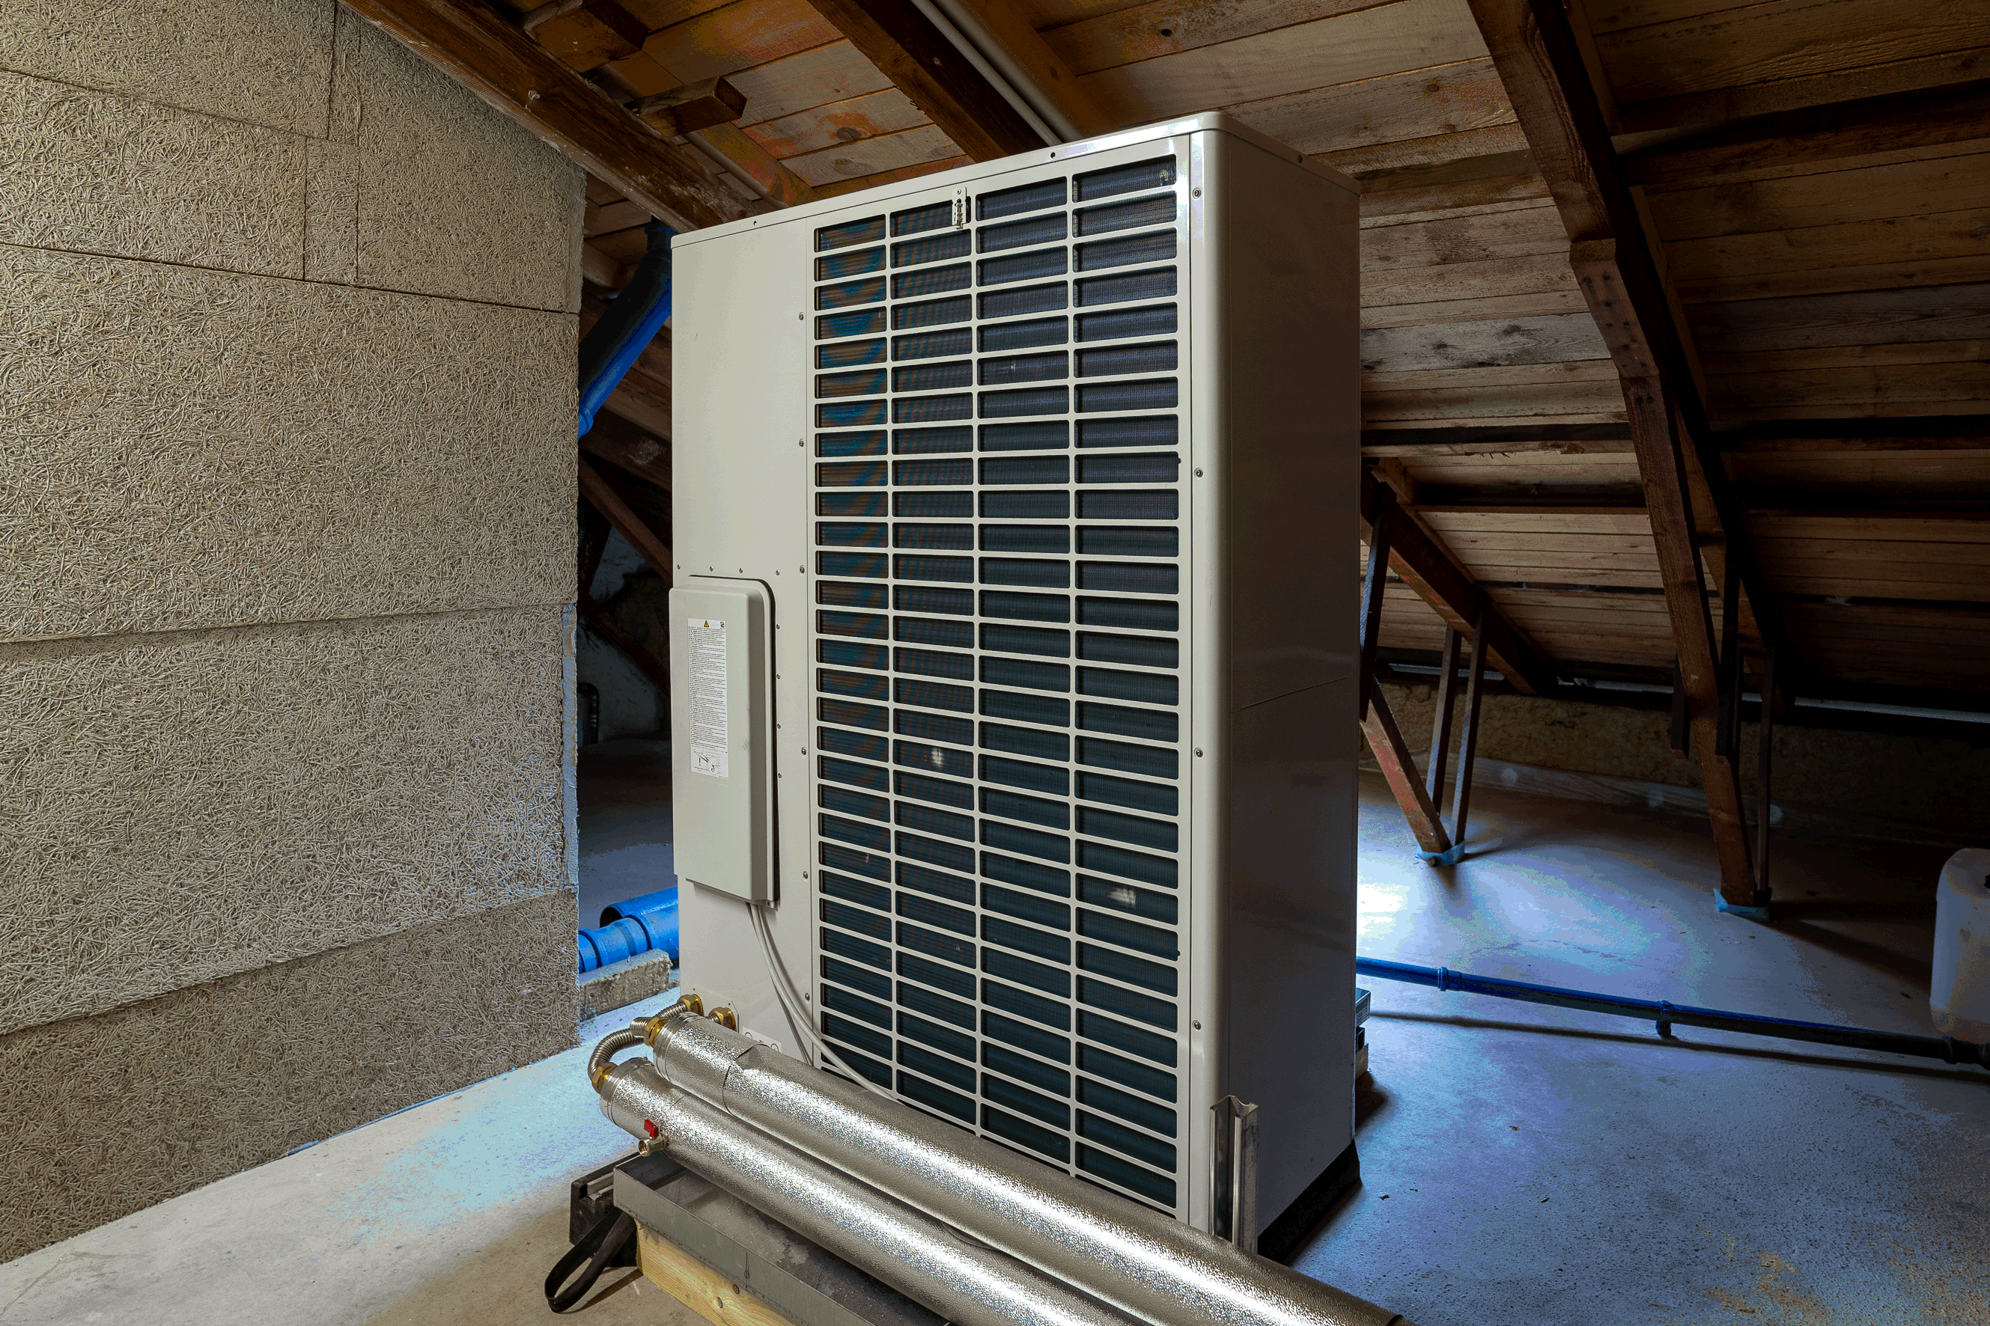
Photo 1: central heating in the attic
Notes:
In the background the heating room with a plasterboard or lattice box enclosure.
In the foreground the horizontal distribution line.

Slide 4
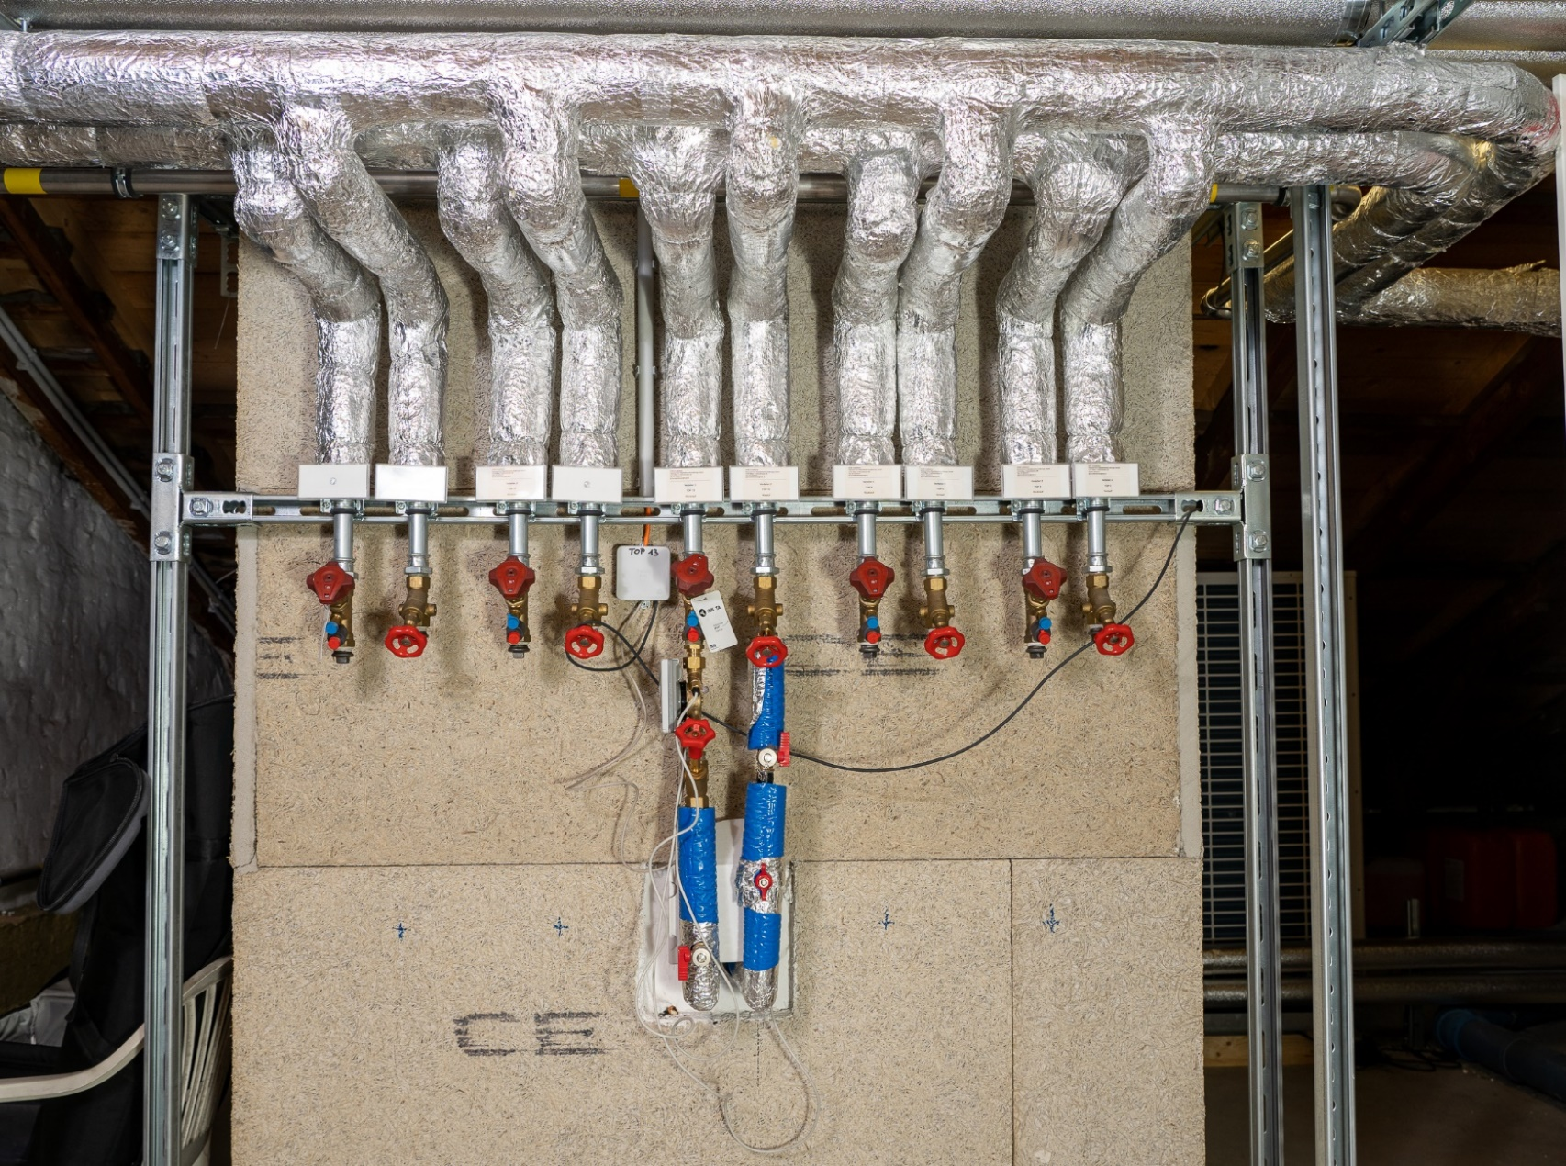
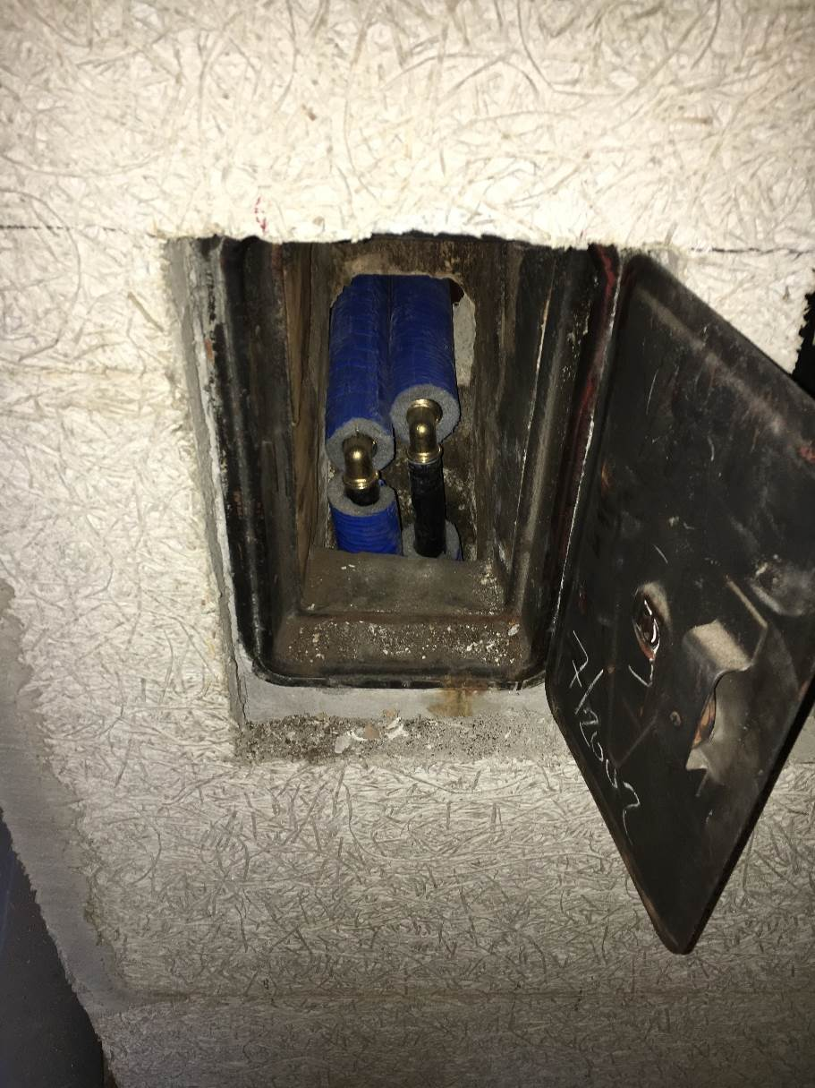
Photo 2: gas connection pipes for the individual flats

Slide 5
Photo 3: graphic representation
In the dwelling
„Combined Gas Heater“
„Collective heater“
Gas Heater
chimney
WW-heater
chimney
WW
WW
Heating line
Heating line
CW
CW

Slide 6
Costs …
The installation costs are about € 3.300,- and € 5.200,- are financed – as for
the replacement of the individual heating in the flats (about € 5.000,-) – with
the savings from the property
The heating costs, that means the costs for energy are invoiced separately
To our tenants acc. to the Heating Costs Ordinance ((HeizKG §2 Z 9+10)
by means of a heating cost metering system.
As a bulk energy buyer we can charge our purchase prices to our customers

Slide 7
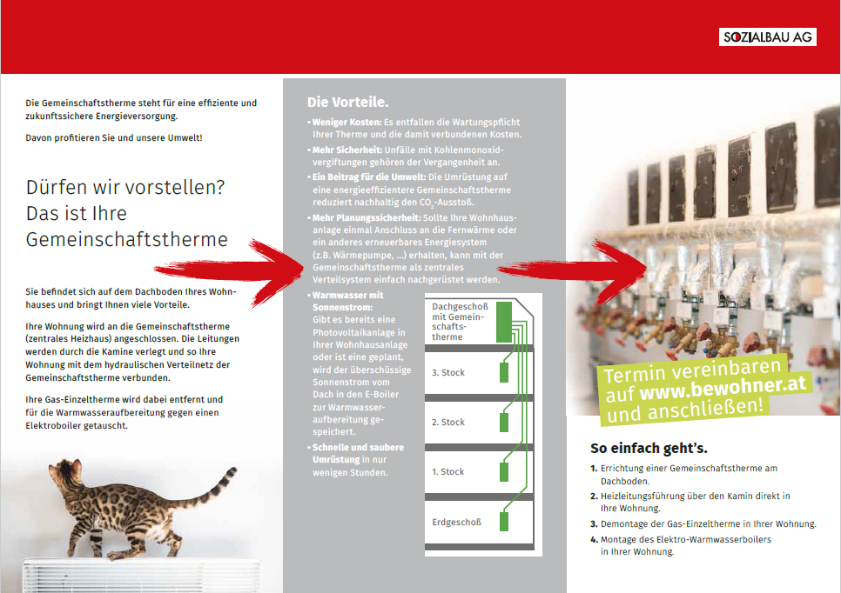
communication with our tenants

Slide 8
communication with our tenants
„video-teaser“ …

Slide 9
thank you for your attention

